Slide 1
Networking Basics

Slide 2
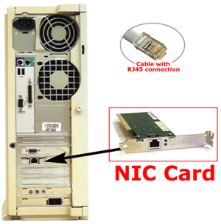
NIC stands for Network Interface Controller (also called network card or network interface)

Slide 3
MAC Address
Media Access Control address (MAC address) is a unique identifier assigned to network interfaces for communications on the physical network segment
00:A0:C9 indicates the manufacturer ( e.g. Intel Corporation)
00:11:22 indicates the unique card ID
00:A0:C9:00:11:22

Slide 4
MAC Address
Each device (smartphone, PC, tablet, etc.) that connects to an IEEE 802 network has a MAC-48 address
The 48-bit address space contains potentially 2⁴⁸ or 281,474,976,710,656 possible MAC addresses.
Although MAC address intends to be permanent and globally unique identification, it is possible to change MAC address (MAC spoofing).
Notes:
According to Edward Snowden, the National Security Agency has a system that tracks the movements of everyone in a city by monitoring the MAC addresses of their electronic devices.^{[13]} As a result of users being trackable by their devices' MAC addresses,Apple Inc. has started using random MAC addresses in their iOS line of devices while scanning for networks.^{[14]} If random MAC addresses are not used, researchers have confirmed that it is possible to link a real identity to a particular wireless MAC address.

Slide 5
IP Address
An Internet Protocol address (IP address) is a numerical label assigned to each device (e.g., computer, printer) participating in a computer network that uses the Internet Protocol for communication
Two principal functions:
host or network interface identification
routing
Notes:
The Internet Assigned Numbers Authority (IANA) is responsible for the global coordination of the DNS Root, IP addressing, and other Internet protocol resources. This includes the registration of commonly used port numbers for well-known Internet services.

Slide 6
Versions of IP Addressing
Two versions of the Internet Protocol (IP) are in use:
IP Version 4 (uses 32 bits for an IP address)
IP Version 6 (uses 128 bits for an IP address)
IP addresses are binary numbers, but they are usually stored in text files and displayed in human-readable notations

Slide 7
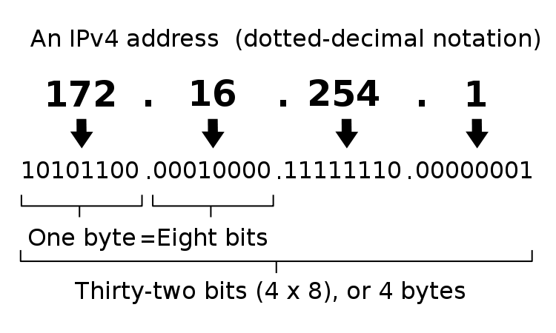
IPv4 limits the address space to 2³², 4,294,967,296 possible unique addresses
Image Source: http://en.wikipedia.org/wiki/File:Ipv4_address.svg
Notes:
In IPv4 an address consists of 32 bits which limits the address space to 4294967296 (2³²) possible unique addresses.
IPv4 reserves some addresses for special purposes such as private networks (~18 million addresses) or multicast addresses (~270 million addresses).

Slide 8
IPv4 Network Ranges
By subnetting to interpret IP address in two parts:
network number portion
host number portion
Class | Address Range | Supports
A | 1.0.0.1 – 126.255.255.254 | 16 mil. hosts on each of the 126 networks
B | 128.1.0.1 – 191.255.255.254 | 65,000 hosts on each of the 16,000 networks
C | 192.0.1.1 – 223.255.254.254 | 254 hosts on each of the 2 million networks
Historical Classful Network Architecture
IP address range | # of addresses | Class
10.0.0.0 - 10.255.255.255 | 16,777,216 | A
172.16.0.0 - 172.31.255.255 | 1,048,576 | B
192.168.0.0 – 192.168.255.255 | 65,536 | C
Reserved Private IPv4 Network Ranges
Notes:
Classful network design allowed for a larger number of individual network assignments and fine-grained subnetwork design.
Subnet masks are used to separate the network portion of the IP address from the host portion.
Classless on the other hand, allows the use of variable length subnet masks, or VLSM, because subnet mask information is included with routing updates. You can have a mixture of different subnet masks in the same routing domain:
- 10.1.0.0/19
- 10.2.0.0/20
- 172.16.8.0/21
- 172.16.16.0/24

Slide 9
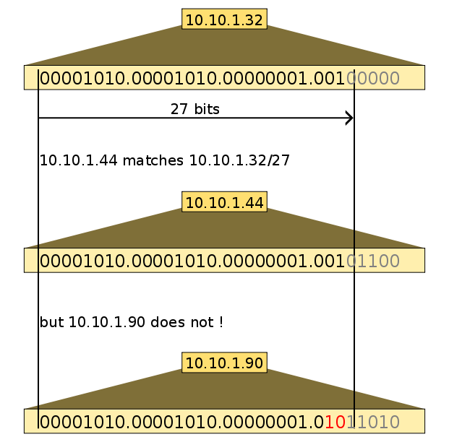
Classless Inter-Domain Routing (CIDR)
Classful network lacks scalability in the face of rapid expansion of the network
Notes:
variable-length subnet masking (VLSM)
All devices in the same routing domain must use the same subnet mask. Since routers running a classful routing protocol do not include subnet mask information with routing updates, the router assumes either its own subnet mask, or defaults to the classful subnet mask.

Slide 10
IP address vs. MAC address
A slight oversimplification:
IP addressing supports inter-network routing
MAC addresses supports intra-network packet delivery
MAC addresses generally remain fixed and follow the network device, but IP addresses change as devices move from one network to another
Notes:
MAC addressing works at the data link layer, IP addressing functions at the network layer (layer 3)

Slide 11
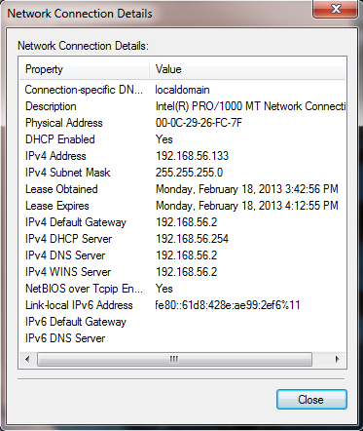
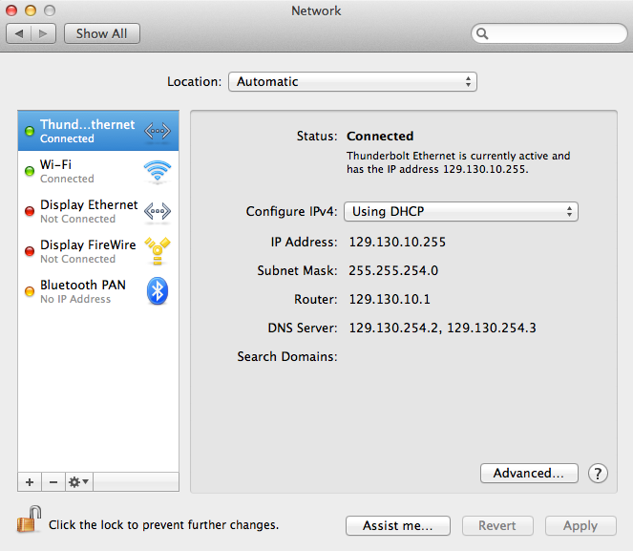
Network Connection Details
Mac OS X
Windows

Slide 12
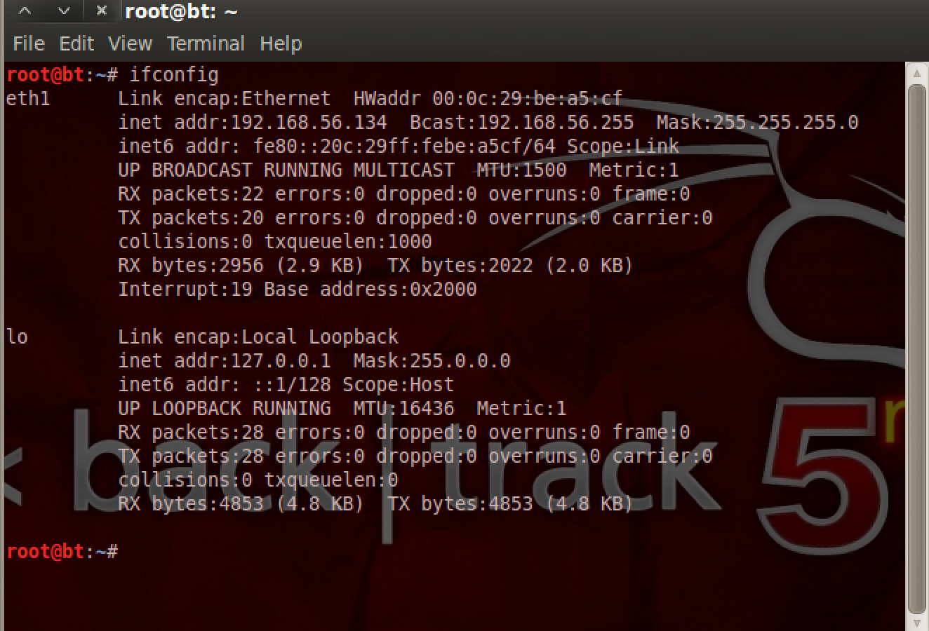
Network Connection Details
Linux - Backtrack 5

Slide 13
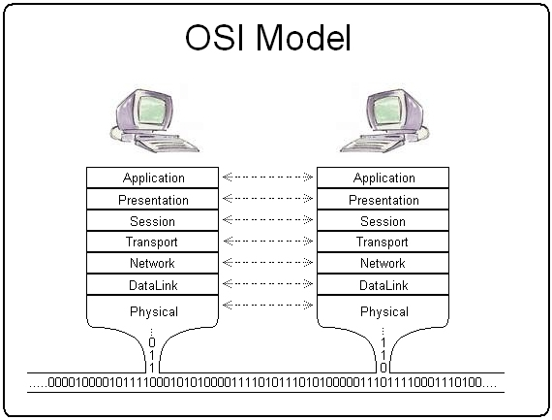
Notes:
Presentation layer: responsible for the delivery and formatting of information to the application layer for further processing, relieves application layer of concern syntactical differences in data representation ASCII code/unicode code or encryption
Session layer: mechanism for opening, closing and managing a session

Slide 14
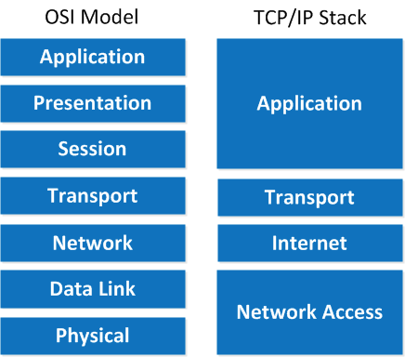
TCP/IP
HTTP, FTP NFS, SMTP, DHCP
TCP, UDP
IPv4, IPv6, ICMP, IGMP
ARP
Notes:
ICMP control message protocol: For IP network management and administration. It does not carry application data for detecting and traceroute
Internet Protocol Suite
Application Layer: BGP, HDCP, DNS, FTP, HTTP, IMAP, LDAP, POP, ONC/RPC, SMTP, SSH, Telnet, TLS/SSL
Transport Layer: TCP, UDP, DCCP, SCTP, RSVP
Internet Layer: IP, ICMP, IPsec
Link Layer: ARP, MAC, PPP

Slide 15
Network Packets
IP packet payload
Ethernet Frame header | IP header | TCP/UDP header | Data | TCP/UDP footer | IP footer | Ethernet Frame footer
Ethernet frame payload

Slide 16
Packet Encapsulation

Slide 17
ARP
The Address Resolution Protocol is a protocol used for resolution of network layer addresses (IP addresses) into link layer addresses (MAC addresses)
It communicate within the boundaries of a single network
An ARP request is transmitted in a broadcast Ethernet frame.
[root@ubuntu]# tcpdump -ennqti eth0 \( arp or icmp \)
tcpdump: listening on eth0
0:80:c8:f8:4a:51 ff:ff:ff:ff:ff:ff 42: arp who-has 192.168.99.254 tell 192.168.99.35
0:80:c8:f8:5c:73 0:80:c8:f8:4a:51 60: arp reply 192.168.99.254 is-at 0:80:c8:f8:5c:73
Notes:
All machines with the same Ethernet broadcast address will receive this packet
Arp request
Arp reply
Rarp request
Rarp reply
tcpdump -ennqti eth0 \( arp or icmp \)
arp –na
ip neighbor
The arp request message ("who is X.X.X.X tell Y.Y.Y.Y", where X.X.X.X and Y.Y.Y.Y are IP addresses) is sent using the Ethernet broadcast address, and an Ethernet protocol type of value 0x806. Since it is broadcast, it is received by all systems in the same collision domain (LAN). This is ensures that is the target of the query is connected to the network, it will receive a copy of the query. Only this system responds. The other systems discard the packet silently.
The target system forms an arp response ("X.X.X.X is hh:hh:hh:hh:hh:hh", where hh:hh:hh:hh:hh:hh is the Ethernet source address of the computer with the IP address of X.X.X.X). This packet is unicast to the address of the computer sending the query (in this case Y.Y.Y.Y). Since the original request also included the hardware address (Ethernet source address) of the requesting computer, this is already known, and doesn't require another arp message to find this out.
This broadcast Ethernet frame, identifiable by the destination Ethernet address with all bits set (ff:ff:ff:ff:ff:ff) contains an ARP request from tristan for IP address 192.168.99.254. The request includes the source link layer address and the IP address of the requestor, which provides enough information for the owner of the IP address to reply with its link layer address.
The ARP reply from masq-gw includes its link layer address and declaration of ownership of the requested IP address. Note that the ARP reply is a unicast response to a broadcast request. The payload of the ARP reply contains the link layer address mapping.

Slide 18
ARP
Resolved addresses are saved in ARP cache
The ARP cache is of finite size and would be full of obsolete entries
ARP cache is periodically flushed

Slide 19
ICMP
The Internet Control Message Protocol is used for diagnostic, error response, and control purposes
The ICMP packet is encapsulated in a IPv4 packet
Type 0 Echo Reply
Type 3 Destination Unreachable (network/host/protocol/etc. unreachable)
Type 5 Redirect Message
Type 8 Echo Request
Type 11 Time Exceeded
Notes:
e.g. requested service is not available or that a host or router could not be reached, ping, traceroute
For example, every device (such as an intermediate router) forwarding an IP datagram first decrements the time to live(TTL) field in the IP header by one. If the resulting TTL is 0, the packet is discarded and an ICMP Time To Live exceeded in transit message is sent to the datagram's source address.
Redirect:
The message informs a host to update its routing information (to send packets on an alternative route). If a host tries to send data through a router (R1) and R1 sends the data on another router (R2) and a direct path from the host to R2 is available (that is, the host and R2 are on the same Ethernet segment), then R1 will send a redirect message to inform the host that the best route for the destination is via R2. The host should then send packets for the destination directly to R2. The router will still send the original datagram to the intended destination.^{[7]} However, if the datagram contains routing information, this message will not be sent even if a better route is available. RFC 1122 states that redirects should only be sent bygateways and should not be sent by Internet hosts.
Time exceeded:
Time Exceeded is generated by a gateway to inform the source of a discarded datagram due to the time to live field reaching zero. A time exceeded message may also be sent by a host if it fails to reassemble a fragmented datagram within its time limit. Time exceeded messages are used by the traceroute utility to identify gateways on the path between two hosts.

Slide 20
ICMP
Ping utility is implemented using ICMP “Echo request” and “Echo reply” messages
An ICMP echo request packet is sent to target host and waiting for an ICMP echo reply.
It measures the round-trip time from transmission to reception, reporting errors and packet loss
The traceroute can also be implemented using ICMP packets and looking for ICMP TTL and “Destination Unreachable” in response
Notes:
The echo request ("ping") is an ICMP message. The Identifier and Sequence Number can be used by the client to match the reply with the request that caused the reply. In practice, most Linux systems use a unique identifier for every ping process, and sequence number is an increasing number within that process. Windows uses a fixed identifier, which varies between Windows versions, and a sequence number that is only reset at boot time.
The echo reply is an ICMP message generated in response to an echo request; it is mandatory for all hosts and routers, and must include the exact payload received in the request.

Slide 21
ICMP Security
Host discovery, and network scanning is implemented in tools such as nmap, zmap, working by utilizing ICMP echo packets
ICMP can be used in denial-of-service attacks, such as a ping flood
For security consideration, many system configurations provide means to disable reply for ICMP

Slide 22
Transport Layer
Transport layer provides host-to-host communication services for applications
Best-known transport protocol is Transmission Control Protocol (TCP) and User Datagram Protocol (UDP)
TCP is connection-oriented transmissions
UDP is connectionless and used for simpler message transmission

Slide 23
Port Number
The port numbers are divided into three ranges:
well-known ports (0 - 1023)
registered ports (1024 - 49151)
dynamic or private ports (49152 – 65535)
Well-known ports examples:
20 & 21: File Transfer Protocol (FTP)
22: Secure Shell (SSH)
23: Telnet
25: Simple Mail Transfer Protocol (SMTP)
80: Hypertext Transfer Protocol (HTTP) - WWW
443: HTTP Secure (HTTPS)

Slide 24
TCP/IP
HTTP, FTP NFS, SMTP, DHCP
TCP, UDP
IPv4, IPv6, ICMP, IGMP
ARP
Notes:
ICMP control message protocol: For IP network management and administration. It does not carry application data for detecting and traceroute
Internet Protocol Suite
Application Layer: BGP, HDCP, DNS, FTP, HTTP, IMAP, LDAP, POP, ONC/RPC, SMTP, SSH, Telnet, TLS/SSL
Transport Layer: TCP, UDP, DCCP, SCTP, RSVP
Internet Layer: IP, ICMP, IPsec
Link Layer: ARP, MAC, PPP

Slide 25
TCP
Transmission Control Protocol provides reliable host-to-host communication service at an intermediate level between application and Internet Protocol
TCP detects network congestion, traffic load balancing, out of order packet delivery, packet duplicate and lost.
TCP uses a sequence number to identify each byte of data
16-bit checksum
Sliding window flow control

Slide 26
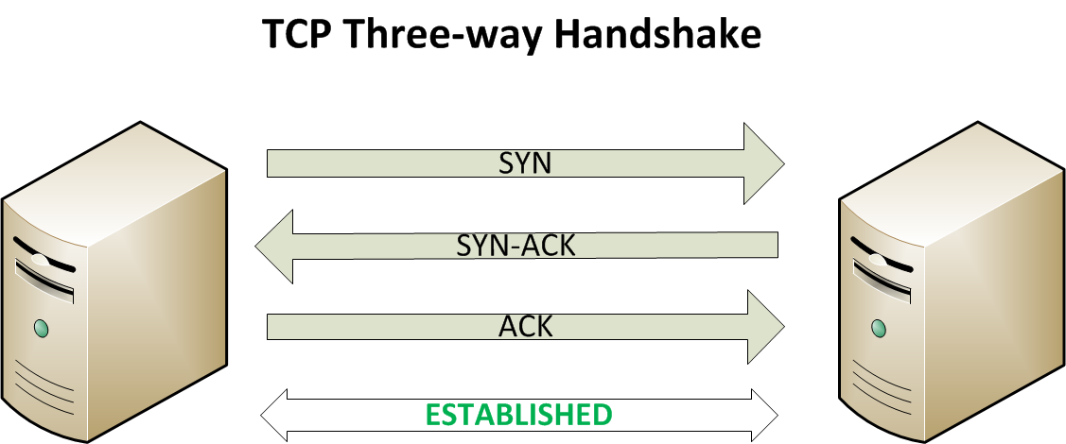
TCP

Slide 27
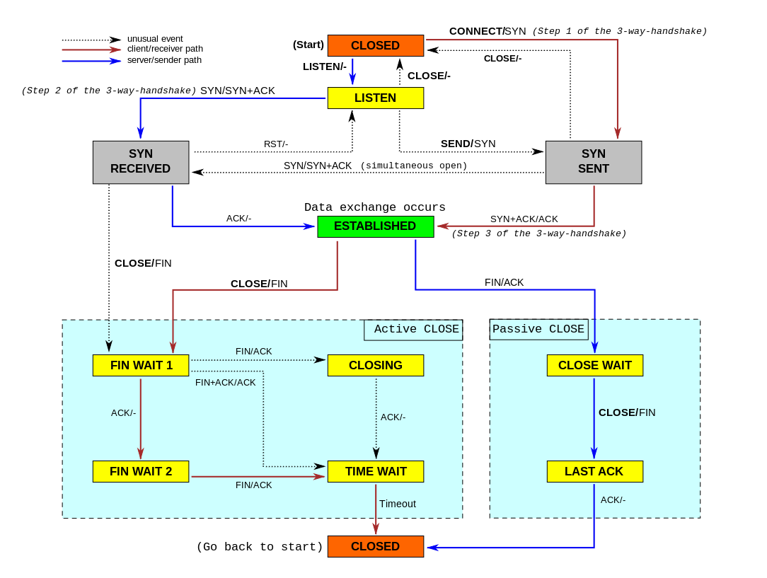
TCP

Slide 28
UDP
User Datagram Protocol is a connectionless transmission protocol
No handshaking dialogues, no guarantee of delivery, ordering and duplication
Suitable for time-sensitive applications
For simple query-response DNS, network time protocol
Bootstrapping without full protocol stack, DHCP
Voice over IP, steaming media
unidirectional communication, broadcasting

Slide 29
DHCP
Dynamic Host Configuration Protocol for automatically distributing network configuration
A client-server model
DHCP client initiates communication by sending broadcast query
DHCP server manages a pool of IP addresses services the request (default gateway, domain name, name servers, etc.)
Dynamic allocation
Automatic allocation
Manual allocation
Notes:
A client typically queries for this information immediately after booting
Dhclient –v –r eth0
Dhclient –v eth0

Slide 30
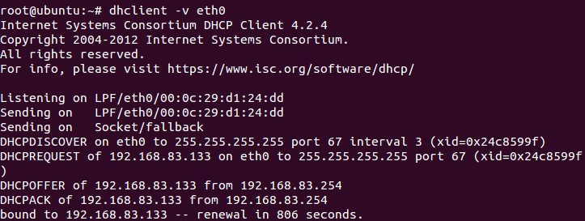
Notes:
DHCP snooping
https://en.wikipedia.org/wiki/DHCP_snooping

Slide 31
DHCP Security
No validation for DHCP server
Rogue DHCP, preventing clients from gaining network access
DHCP has no secure mechanism for authenticating clients
Clients exhaust DHCP server’s IP addresses
Mitigation
DHCP snooping
Notes:
http://itsecurity.telelink.com/dhcp-attacks/
http://www.cisco.com/c/en/us/products/collateral/switches/catalyst-6500-series-switches/white_Paper_C11_603833.html
Yersinia tool:
http://sectools.org/tool/yersinia/

Slide 32
The Domain Name System
Basic Internet Database
Maps names to IP addresses
Also stores IPv6 addresses, mail servers, service locators, Enum (phone numbers), etc.
Data organized as tree structure.
Each zone is the authority for its local data.
Root
edu
com
uk
usf
cisco
ibm
co
cse

Slide 33
DNS
Domain Name System maps names to IP addresses for each domain and provides translation services
DNS is a hierarchical distributed system
DNS server maintains database of DNS resource records
Two types of DNS messages: queries and replies
DNS primarily uses UDP on port 53 to serve requests

Slide 34
Domain Name Service
Provides binding between URL and IP address
Both forward and reverse mapping
Divide URL space into zones; Each name server handles mapping in its zone
DNS Resource Record (RR)
Can be viewed as tuples of the form
<name, TTL, class, type, data>
types: A (IP address)
MX (mail servers)
NS (name servers)
PTR (reverse look up)

Slide 35
DNS Protocol
What is the IP address of www.usf.edu?
root Server
Go ask 192.41.162.30
What is the IP address of www.usf.edu?
ISP
NS Server for edu (192.41.162.30)
What is the IP address of www.usf.edu?
Go ask 131.247.100.1
What is the IP address of www.usf.edu?
131.247.182.171
ISP’s DNS Resolver
NS Server for usf.edu (131.247.100.1)
Notes:
https://www.verisign.com/en_US/domain-names/online/how-dns-works/index.xhtml

Slide 36
Example
Response from the .edu NS server
Delegation of authority
;; QUESTION SECTION:
;www.usf.edu. IN A
;; AUTHORITY SECTION:
usf.edu. 172800 IN NS mother.usf.edu.
usf.edu. 172800 IN NS ziggy.usf.edu.
usf.edu. 172800 IN NS clemson-ns1.usf.edu.
;; ADDITIONAL SECTION:
mother.usf.edu. 172800 IN A 131.247.100.1
ziggy.usf.edu. 172800 IN A 131.247.1.40
clemson-ns1.usf.edu. 172800 IN A 205.186.58.129
…
Glue records

